Slide 1
5.7 Projections and best approximations

Slide 2
Introduction
In this topic, we will
Define the projection of one vector onto another
This will be the best approximation of one vector as a scalar multiple of another
First find the formula for real finite-dimensional vectors and then discuss the formula for complex finite-dimensional vectors
Look at some examples and properties
Look at projections of functions onto functions
Discuss the average value of vectors

Slide 3
Projections for real inner-product spaces
Now, given two vectors u and v, clearly u is not a very good approximation of v
However, 0.4u seems to be a better approximation of v
u
v

Slide 4
Projections for real inner-product spaces
Question: Which scalar multiple of u is the best approximation of v?
For this, we need a definition of “best”
u
v

Slide 5
Projections for real inner-product spaces
Most reasonable: Which scalar multiple of u is closest to v
That is, find that multiple that minimizes
Recall that the function x² is monotonic for x ≥ 0,
that is, x < y if and only if x² < y²
u
v

Slide 6
Projections for real inner-product spaces
Thus, finding a minimum of is equivalent to finding a minimum of

Slide 7
Projections for real inner-product spaces
Therefore,
Remember that u and v are given, so
are all constants!
For what value of α is a minimum?
This assumes c₂ > 0
Differentiate, equate to zero and solve for α:
Thus,

Slide 8
Projections for real inner-product spaces
Substituting in the two coefficients,

Slide 9
Projections for real inner-product spaces
Thus, the best approximation of v as a scalar multiple of u is
u
v

Slide 10
Projections for real inner-product spaces
Note that this formula assumes that .
Let us define
That is, the best approximation of any vector by a multiple of the zero vector is the zero vector…

Slide 11
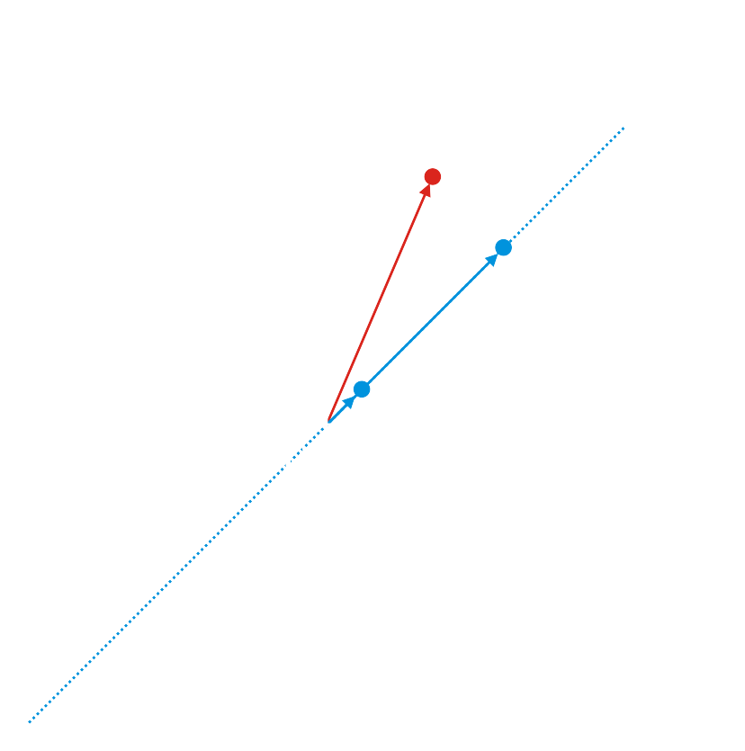
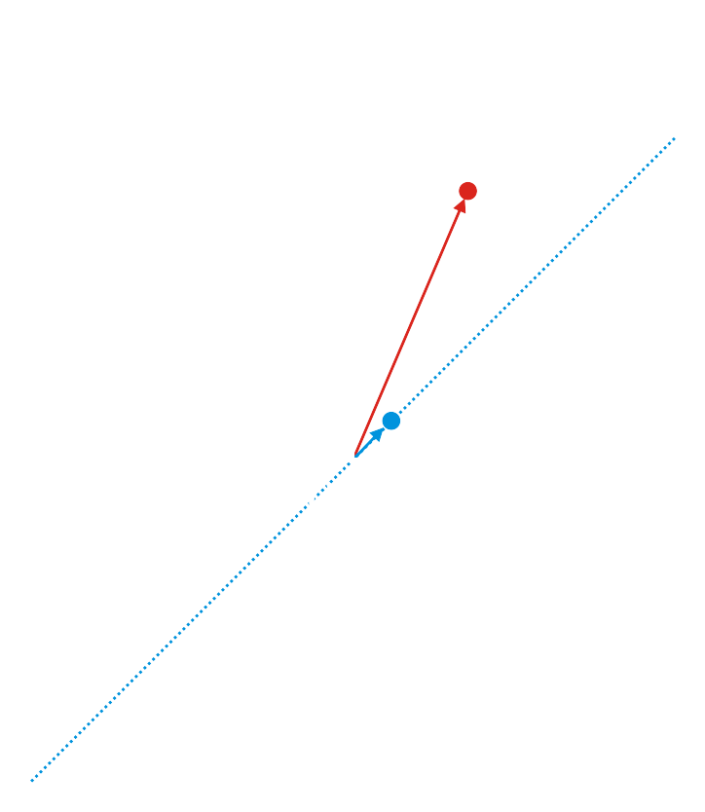
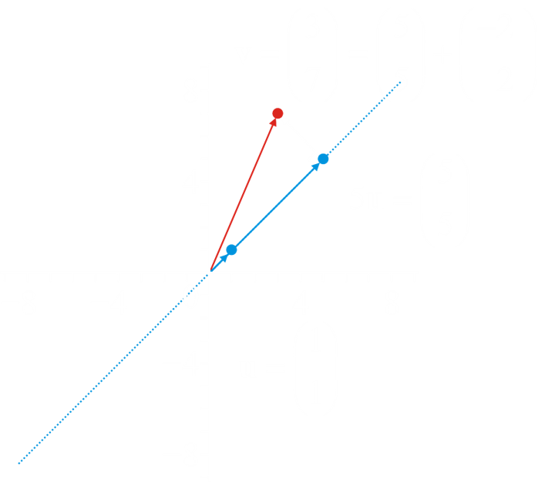
Projections for real inner-product spaces
For example, given and

Slide 12
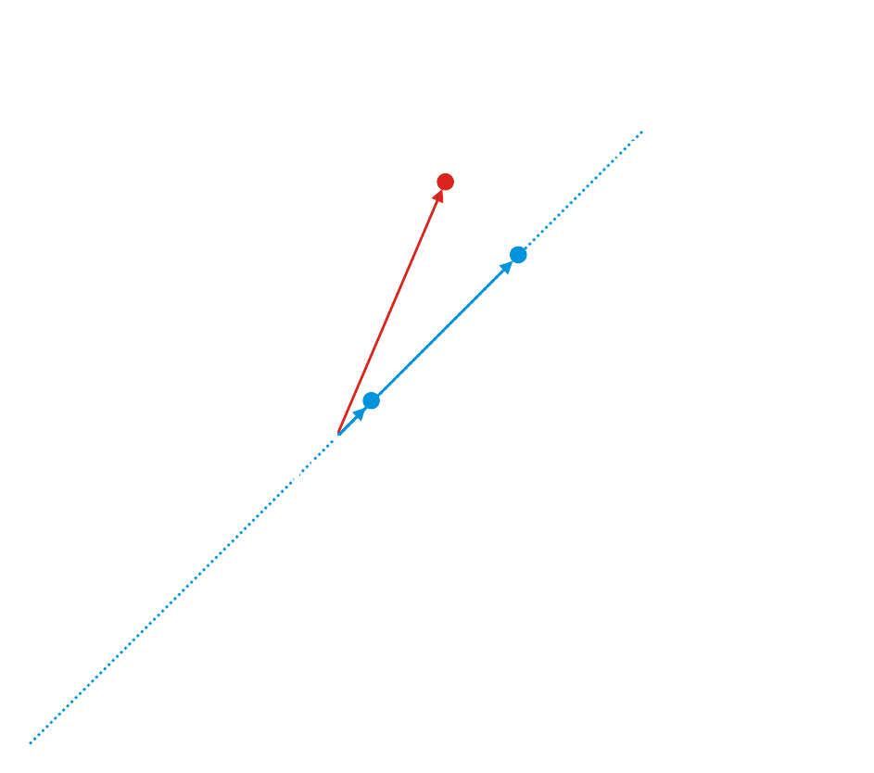
Projections for real inner-product spaces
For example, given and

Slide 13
Projections for real inner-product spaces
For example, given and

Slide 14
Projections for real inner-product spaces
For example, given and

Slide 15
Projections for complex inner-product spaces
In finding the projection for real inner-product spaces,
we used the symmetry property:
Complex vectors, however, do not have this property:
they are conjugate symmetric
Fortunately, the same formula holds, and the detailed derivation is in the text book:

Slide 16
Properties of projections
A function f is idempotent if f (f (x)) = f (x) for all x
That is, once the function is applied,
subsequent applications do not affect the result
You already know many idempotent function:
The absolute value function
The ceiling function
The floor function

Slide 17
Properties of projections
Theorem:
The projection is idempotent; that is,
Proof:
▮

Slide 18
Properties of projections
A function f is linear if f (α u + β v) = α f (u) + β f (v)
for all possible values of α, β, u and v
Consider the function
Note that

Slide 19
Properties of projections
More useful, the derivative is linear:
For example,

Slide 20
Properties of projections
Theorem:
The projection is linear.
Proof:
▮

Slide 21
Properties of projections
Theorem:
Proof:
First,
But, so apply the Pythagorean theorem
Because each of these terms is non-negative,
Because the square-root function is monotonic for x ≥ 0,

Slide 22
Properties of projections
Next, if , then
By the Pythagorean theorem, so
and the projection is a scalar multiple of u.
Otherwise, assume v = α u, so
▮

Slide 23
Properties of projections
Theorem:
If is a unit vector, then .
Proof:
But , and if is a unit vector, ,
Therefore, , so
▮

Slide 24
Properties of projections
Theorem:
if and only if .
Proof:
If u = 0, then this is obviously true, and the zero vector is perpendicular to all vectors.
If ,
▮

Slide 25
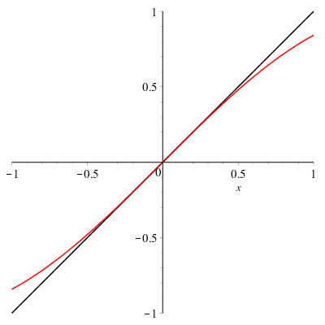
Projections in other vector spaces
We will look at projections in one other vector space
You are not responsible for this!
Let us find the best scalar multiple of x that approximates the sine function on the interval [–1, 1]
Now, y = x is a great approximation of sin(x) close to x = 0
Unfortunate, the error is larger closer to the boundaries

Slide 26
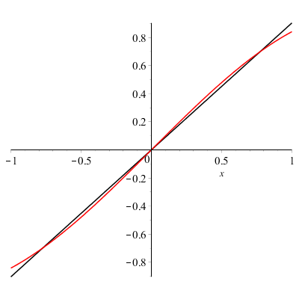
Projections in other vector spaces
Evaluating these, we get:
This is approximately the polynomial 0.9035 x

Slide 27
Projections in other vector spaces
Let us find the constant function that approximates the sine function on the interval [–1, 1]
Every constant function is a multiple of y = 1, that is,

Slide 28
Best approximation by constant vector
Note that if , then the best approximation of any vector by a scalar multiple of 1 is the average value of the entries
Therefore,

Slide 29
Summary
Following this topic, you now
Know the formula for the projection of one vector onto another
Understand that the projection is the best approximation of one vector by a scalar multiple of another
Know that
The projection is idempotent and linear
The 2-norm of the projection of v onto another vector is always less than the 2-norm of v
The formula of the projection onto u simplifies if u is a unit vector
The projection of v onto u is 0 if and only if u and v are perpendicular
Have seen projections of functions and other results

Slide 30
References
[1] https://en.wikipedia.org/wiki/Projection_(linear_algebra)
[2] https://en.wikipedia.org/wiki/Orthogonality

Slide 31
Acknowledgments
Edward Hong for noting I forgot to cancel an α on Page 6 after it was factored out.
Mac Qiu for noting one slide had the vector (2, –2) instead of (–2, 2)

Slide 32
Colophon
These slides were prepared using the Cambria typeface. Mathematical equations use Times New Roman, and source code is presented using Consolas.
The photographs of flowers and a monarch butter appearing on the title slide and accenting the top of each other slide were taken at the Royal Botanical Gardens in October of 2017 by Douglas Wilhelm Harder. Please see
https://www.rbg.ca/
for more information.

Slide 33
Disclaimer
These slides are provided for the ne 112 Linear algebra for nanotechnology engineering course taught at the University of Waterloo. The material in it reflects the authors’ best judgment in light of the information available to them at the time of preparation. Any reliance on these course slides by any party for any other purpose are the responsibility of such parties. The authors accept no responsibility for damages, if any, suffered by any party as a result of decisions made or actions based on these course slides for any other purpose than that for which it was intended.

